Slide 1
Standing Waves

Slide 2
What can you notice?

Slide 3
Standing waves
Two waves of the same amplitude and frequency travelling in opposite directions
Usually, one wave is the reflection of the other
Regions of high amplitude
Areas where amplitude is always zero
Length must be a multiple of the wavelength (or half multiple)
The wave does not appear to be travelling down the string
They will only occur at certain frequencies- dependant on the medium

Slide 4
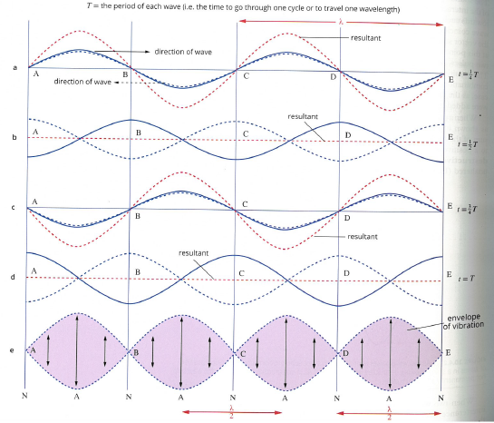

Slide 5
Some definitions
Nodes- The parts of the standing wave whose amplitude is always zero
For strings, there will always be a node at each end
Antinodes- The parts of the standing wave where maximum displacement occurs.
These will be λ/4 from the nodes.

Slide 6
Harmonics
We can create many different standing waves on a string. Certain conditions must be kept
A whole half-number of wavelengths must be equal to the length of the string, eg,
λ/2, 2λ/2, 3λ/2, 4λ/2, 5λ/2, etc.
As wavelength and frequency are related, this means only certain frequencies can occur as standing waves.

Slide 7

The equation (for strings)
$$λ=\frac{2l}{n}$$
λ = wavelength
l = length of the string
n = mode of the wave (number of antinodes)
Also called harmonic number

Slide 8
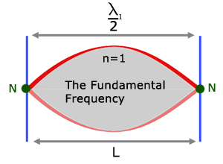
First harmonic (Fundamental)

Slide 9
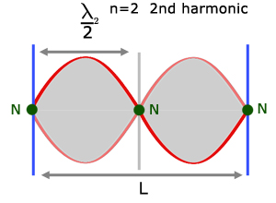
Second Harmonic (first overtone)

Slide 10
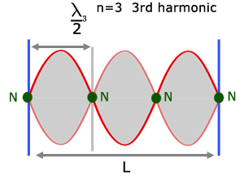
Third Harmonic (second overtone)

Slide 11

More equations (not on formula and data sheet)
$$f_{n}=\frac{nv}{2l}$$
$$f_{n}=nf_{1}$$

